Slide 1

Houses: The Lost American Dream
Python Project Team Members: Marvina L., Ciin Cing, Dren L.

Slide 2

Project Details
Our project focuses on the Home Prices and Interest Rates focusing on houses on average in the US overall. Also, alongside four states for comparison with how Those two key factors may have been impacted.

Slide 3

Where we got our data
This is our data sources:
https://www.kaggle.com/datasets/federalreserve/interest-rates
https://www.bankrate.com/banking/federal-reserve/history-of-federal-funds-rate/#2001
https://fred.stlouisfed.org/series/MDSTHPI
https://fred.stlouisfed.org/series/TXSTHPI#0
https://fred.stlouisfed.org/series/CTSTHPI
https://fred.stlouisfed.org/series/USSTHPI
https://www.macrotrends.net/2015/fed-funds-rate-historical-chart

Slide 4

hypothesis
We predict the average home price in CT, MD, TX, and WA will fluctuate with the average US pricing along with the Federal Funds Rate.

Slide 5

Data merging & Formatting Process
After gathering the different sources of data

Slide 6
Modification of data
There was a few modifications and updates needed for the sheets including renaming columns, cutting down a few raw csv.files and rearranging dates to appear like the other sheets we had cleaned.
Some of the functions used were pandas DataFrame, averaging monthly numbers for Quarters, .datetime, read.csv, dt.to_period, dt.to_timestamp, and others.
Once these modifications were made, we were able to seamlessly connect our sheets together to be easily turned into graphs and plots that could be read visually.

Slide 7
Plotting the Data
Ciin types stuff here ☺

Slide 8
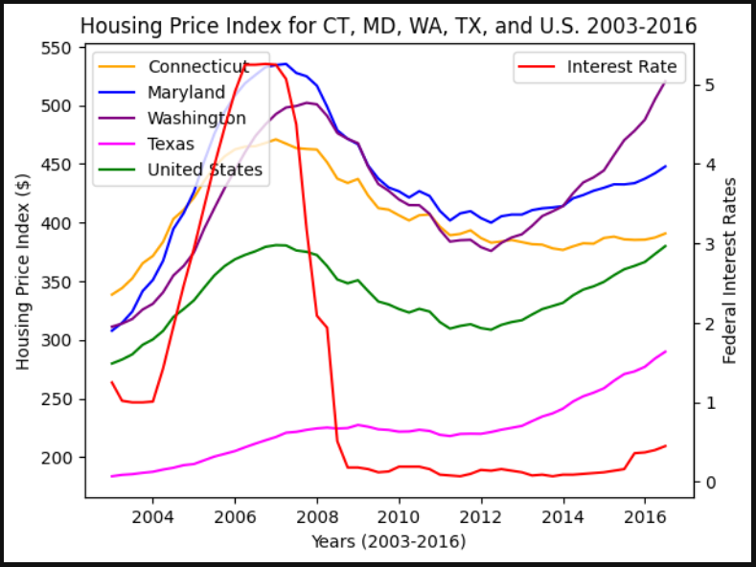
Final graph visualization
This graph shows from the 4 states(CT, MD, TX, WA) how they were originally were aligned with the Interest Rate but the sudden decline in 2008 threw this off.

Slide 9

conclusion
Interest Rate did not have as big as an impact on the Housing Prices as we initial thought it would. The prices decreased on a slow decline due to government intervention to encourage house buying after the housing bubble burst in 2008. The interest rates were cut sharply regarding this as well.
What has happened is the interest rate was cut sharply in 2008 due to the housing crisis to encourage house buying while mostly retaining the Housing Prices. Which leads to the graphs showing a sudden decline while a steady pricing line remains.
Overall, our hypothesis was proven partially incorrect. Originally, the Interest Rate did have a larger impact initially, but other factors decreased its effect substantially for years beyond 2008.

